Slide 1

Customer Segmentation
Bhavesh Khanchandani
© All rights reserved by Fireblaze Technologies Pvt. Ltd.

Slide 2
Problem Statement
A company that sells some of the product, and you want to know how well the selling performance of the product. You have the data that we can analyze, but what kind of analysis can we do? Well, we can segment customers based on their buying behavior on the market.
Keep in mind that the data is really huge, and we can not analyze it using our bare eyes. We will use machine learning algorithms and the power of computing for it.
This project will show you how to cluster customers on segments based on their behavior using the clustering algorithm in Python.
© All rights reserved by Fireblaze Technologies Pvt. Ltd.

Slide 3
Proposed Solution
Data Preprocessing : This step performs all pre-processing steps such as data manipulation, data filling, converting categorical into numeric, and all processes. The EDA process involves performing 1. Univariate Analysis 2. Bivariate analysis 3. Removing Missing values if any / Outlier treatment 4. Machine Learning : Build a clustering model to segment the customer-based similarity.Also fine-tune the hyper parameters & compare the evaluation metrics of various classification algorithms
© All rights reserved by Fireblaze Technologies Pvt. Ltd.

Slide 4
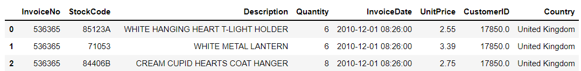

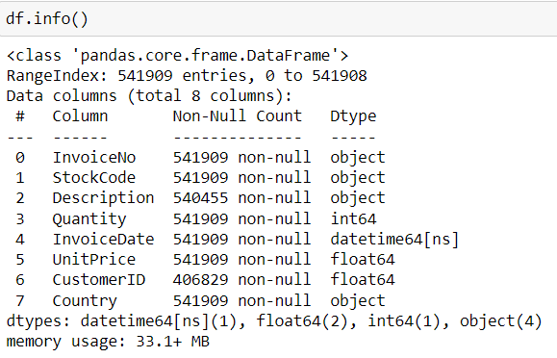
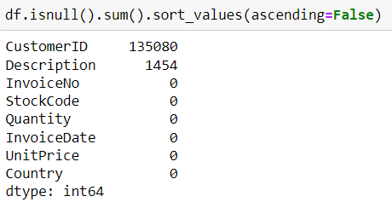
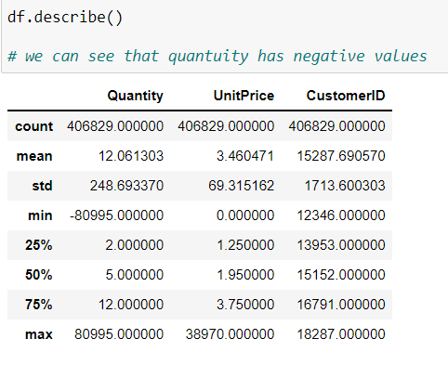
Descriptive Analysis
© All rights reserved by Fireblaze Technologies Pvt. Ltd.

Slide 5
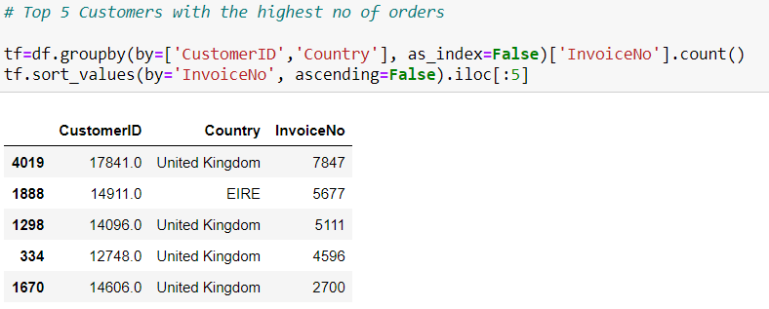
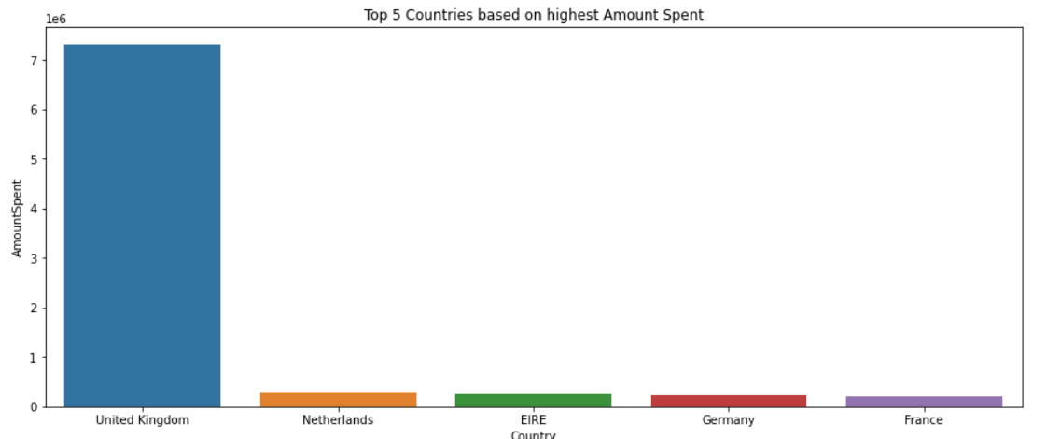
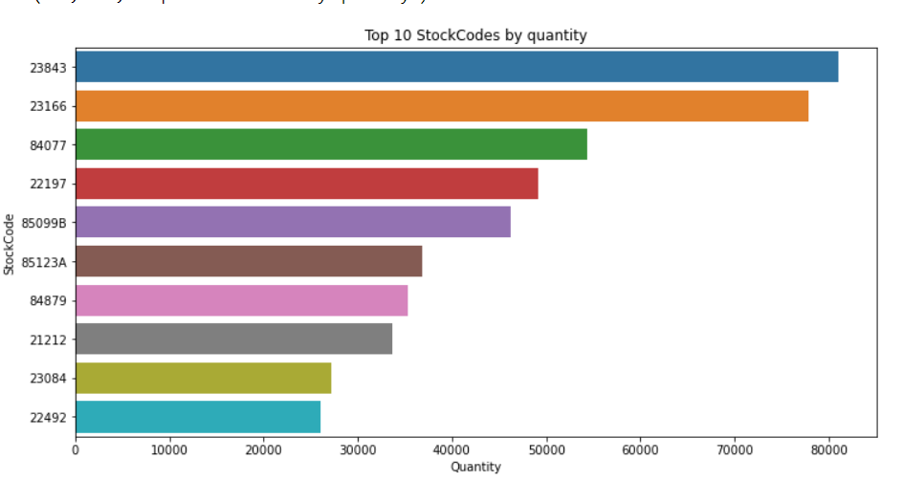
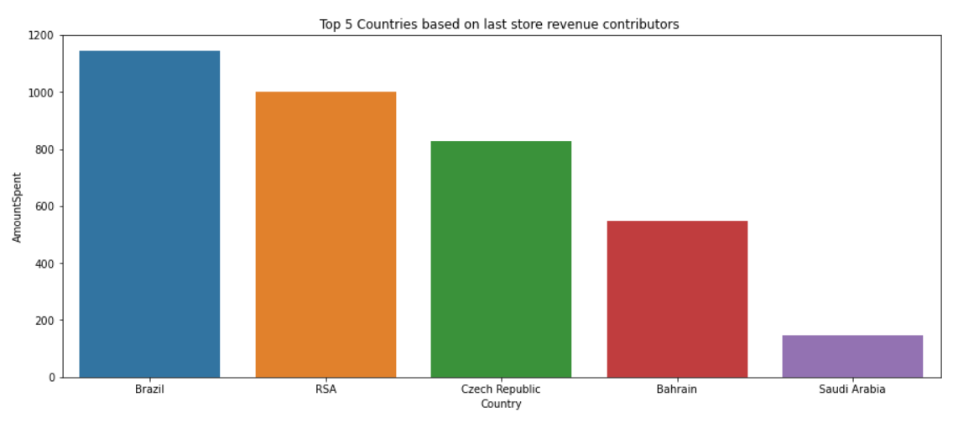
Exploratory Data Analysis
© All rights reserved by Fireblaze Technologies Pvt. Ltd.

Slide 6
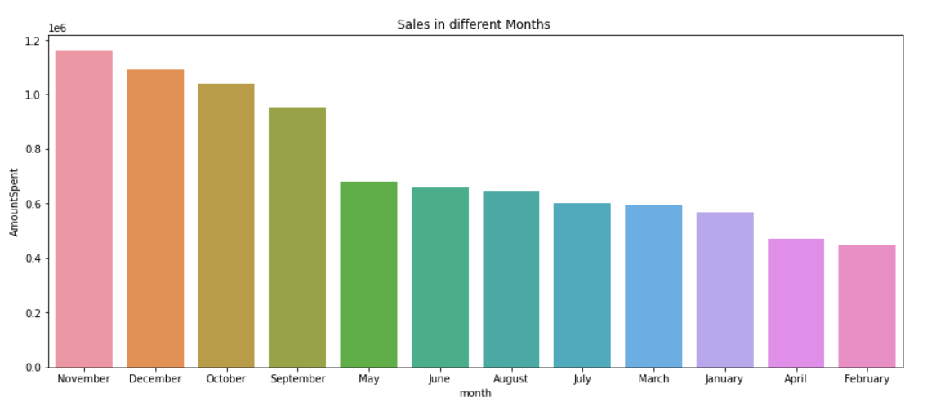
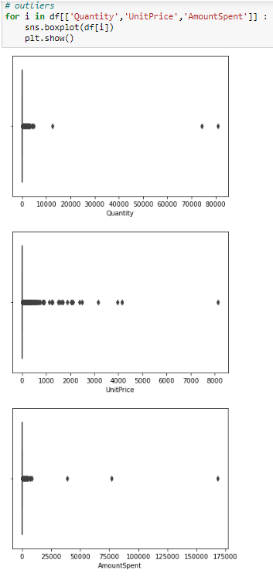
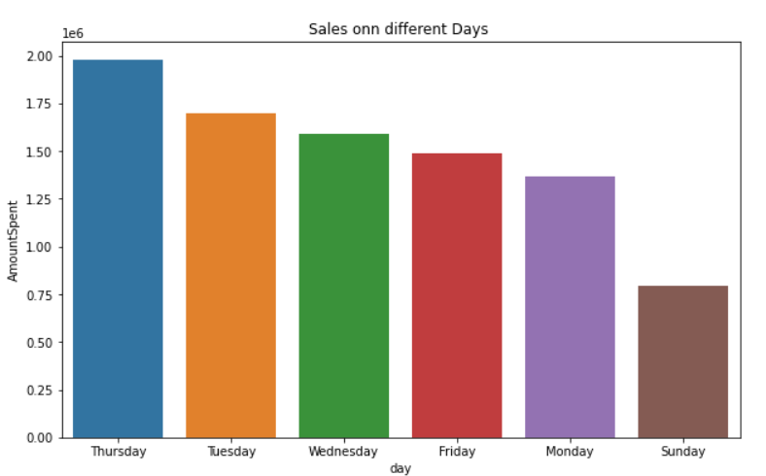
Exploratory Data Analysis
© All rights reserved by Fireblaze Technologies Pvt. Ltd.

Slide 7
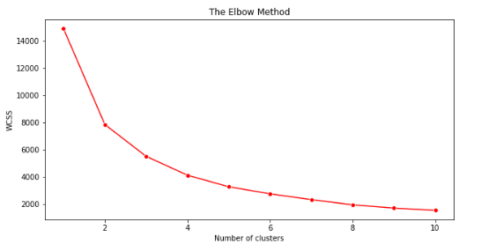
Machine Learning Modelling
Feature selection for algorithm
X = df[['AmountSpent','CustomerID']].values
Normalize Data using MimMaxScaler
Find the best value for K using Elbow Method
Number of cluster = 2
© All rights reserved by Fireblaze Technologies Pvt. Ltd.

Slide 8
Optimisation
© All rights reserved by Fireblaze Technologies Pvt. Ltd.

Slide 9
Conclusion
© All rights reserved by Fireblaze Technologies Pvt. Ltd.

Slide 10
Future Scope
© All rights reserved by Fireblaze Technologies Pvt. Ltd.

